Slide 1
Electric cookstove adoption in Tanzania Susanna Berkouwer (Penn Wharton) Joshua Dean (Chicago Booth) Timeline: Pilot in July-August 2024 (N=200) Launch in Q1 2025 (N=2000)

Slide 2
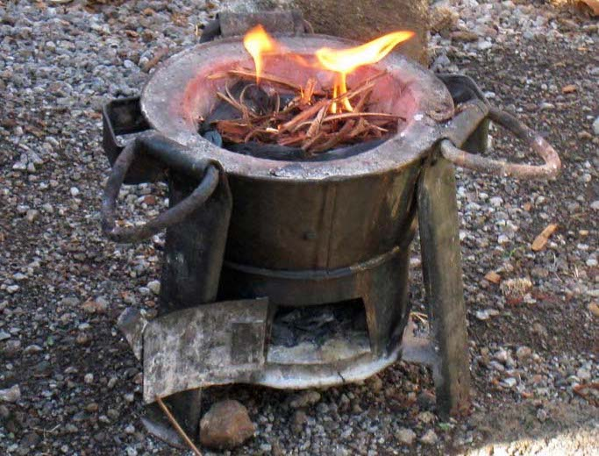
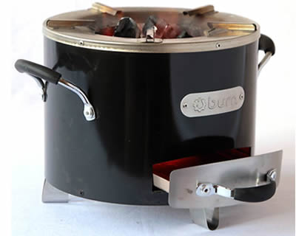
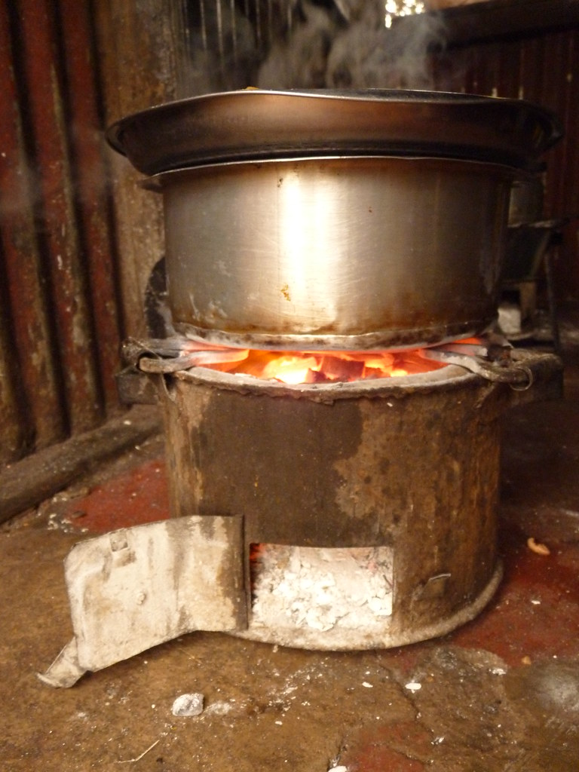
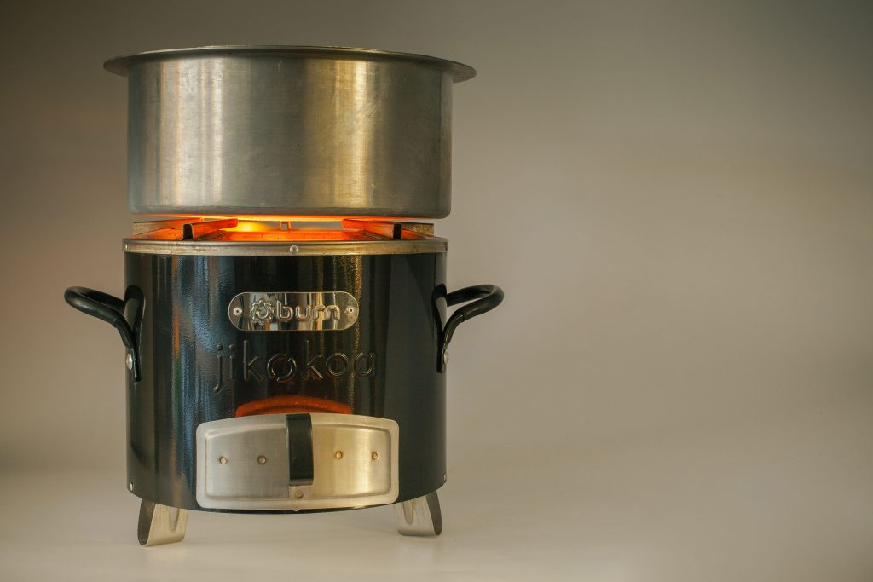

Slide 3
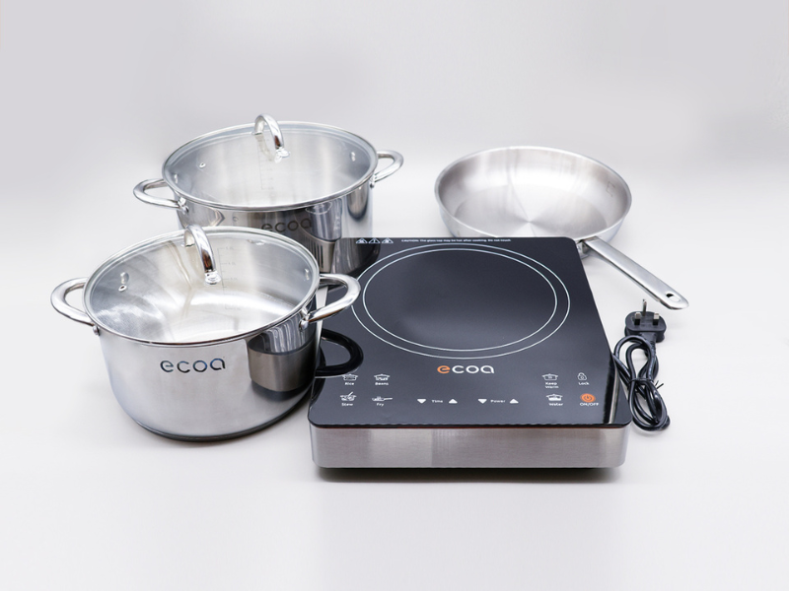
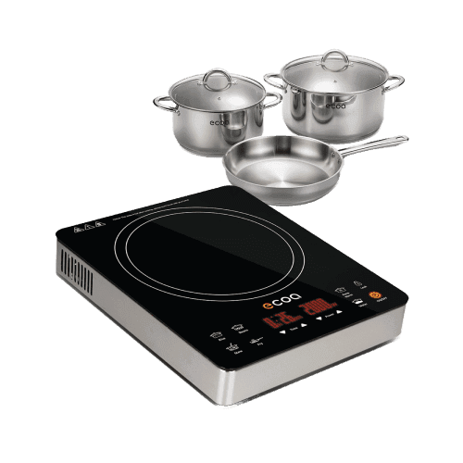

Slide 4
Benefits
Save money?
Save time?
Healthier?
Reduce CO2 (Kenya’s grid is 50% geothermal, 40% hydro)

Slide 5
Why might people not want to adopt an electric cookstove?

Slide 6
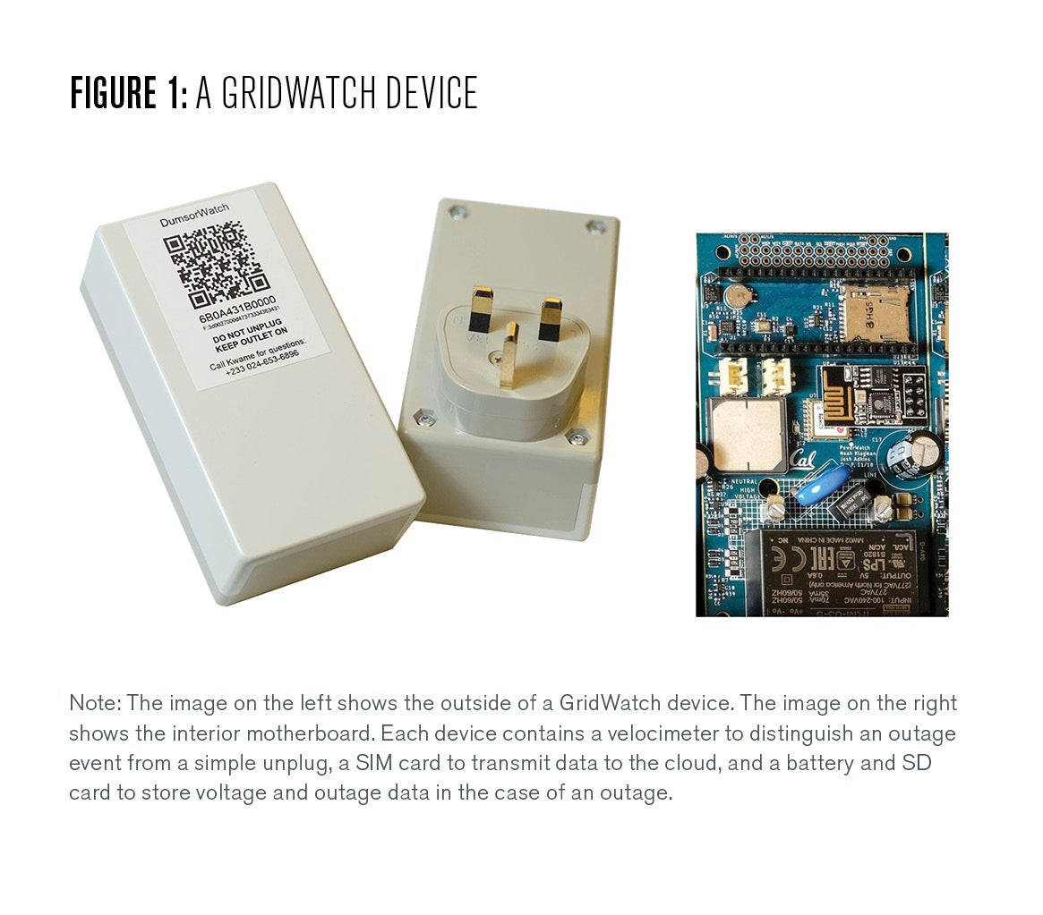
Why might people not want to adopt an electric cookstove?

Slide 7
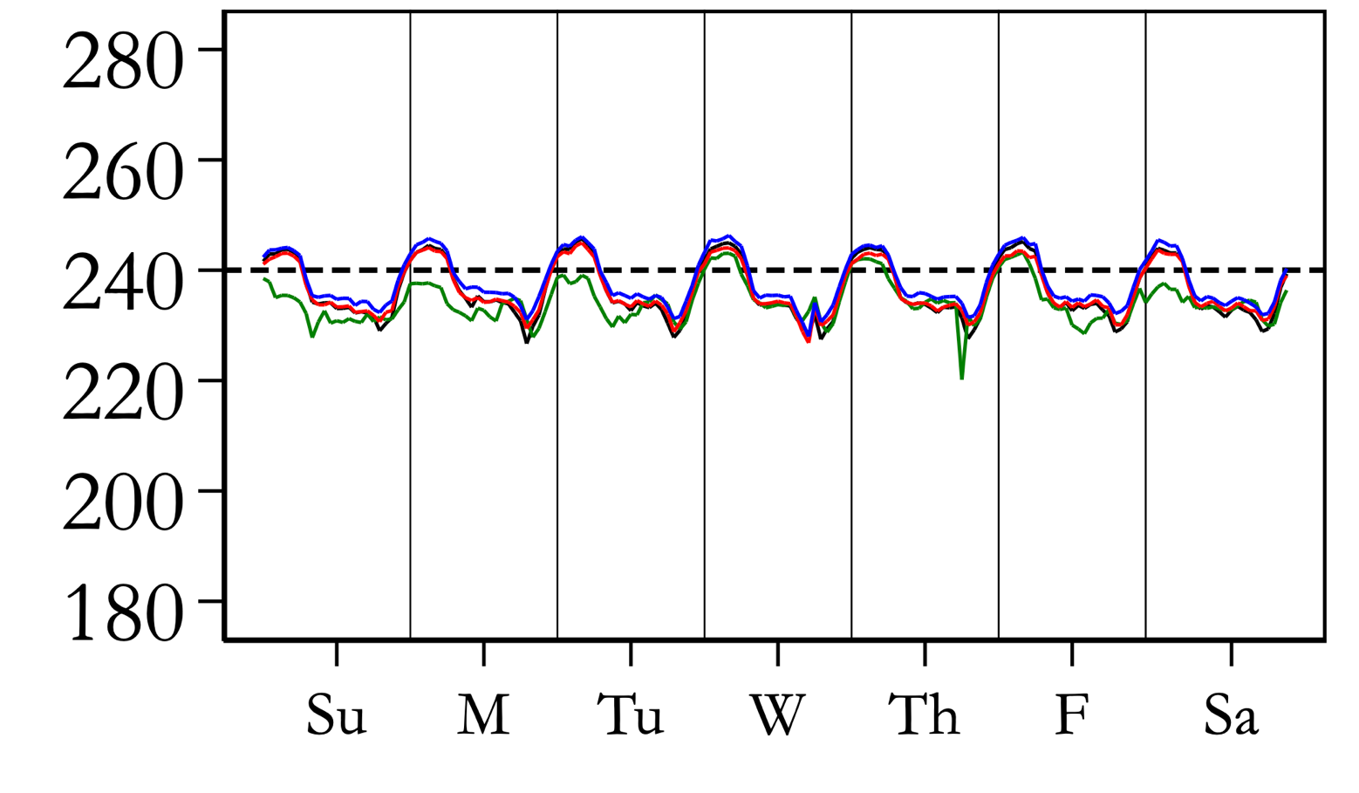
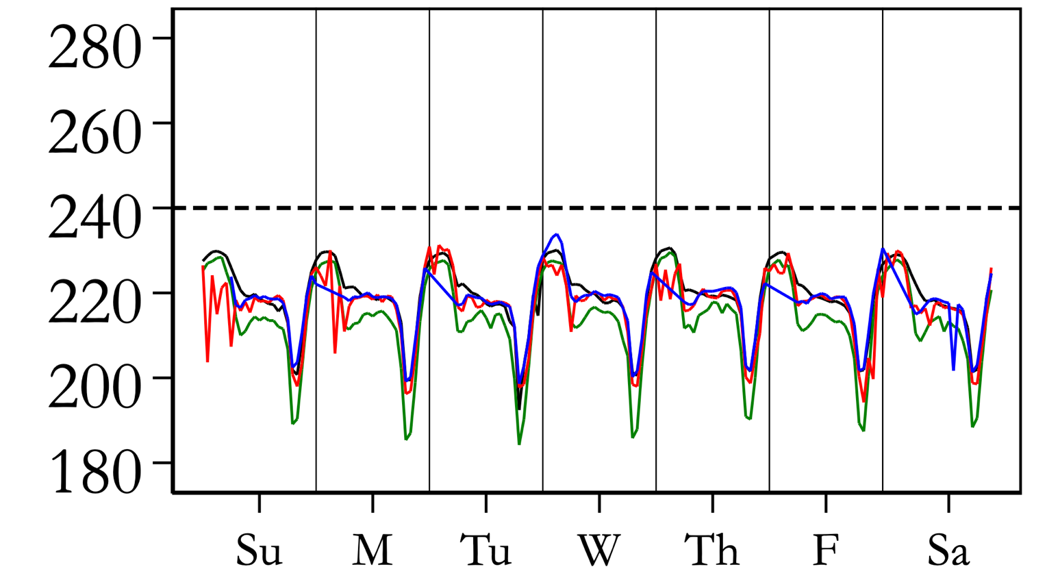
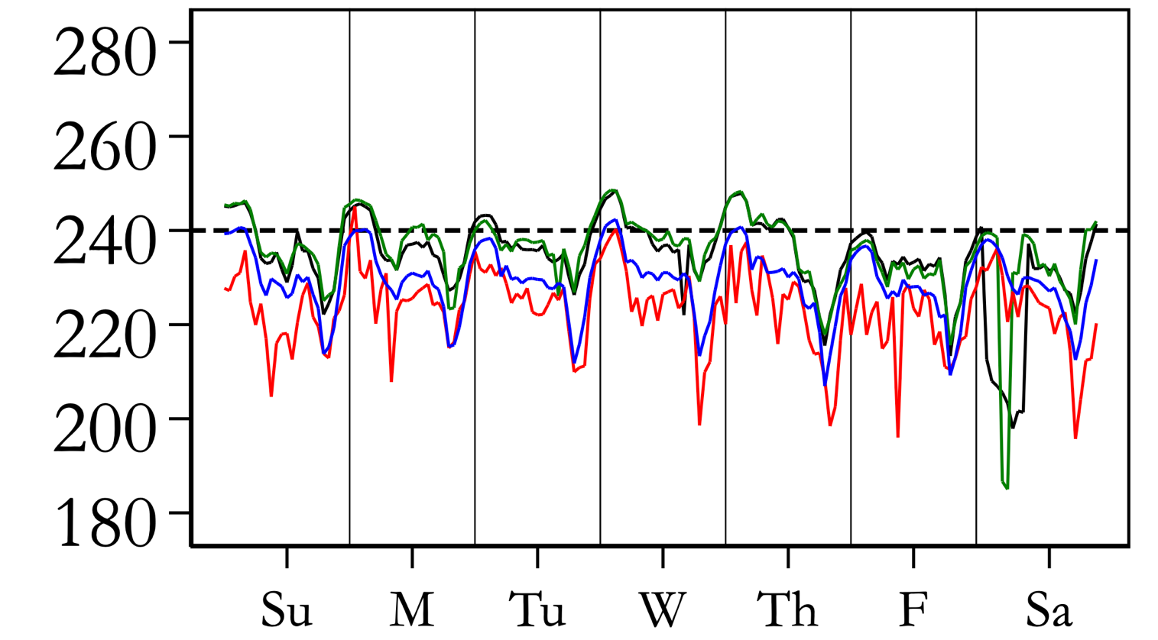
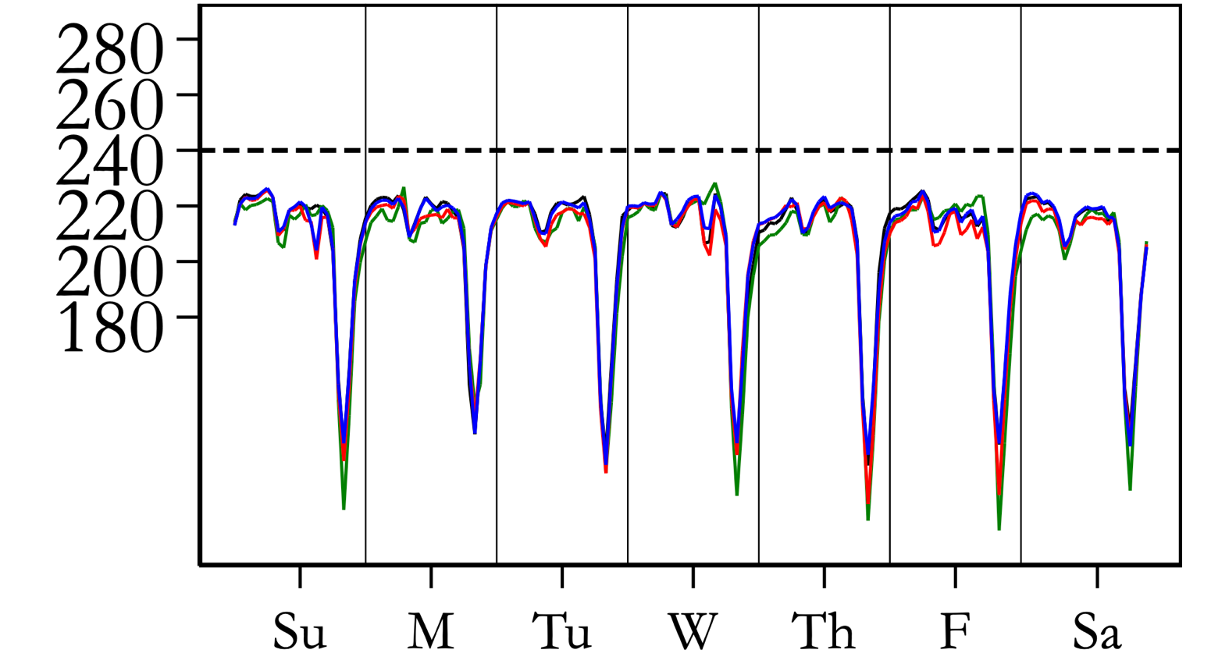
Why might people not want to adopt an electric cookstove?
Tieng’re Transformer, Seme Constituency, Kisumu
Mwirosti Transformer
Constituency, Kakamega County
Esibeye Transformer, Luanda Constituency, Vihiga
Mukavakava Transformer, Malava Constituency, Kakamega

Slide 9
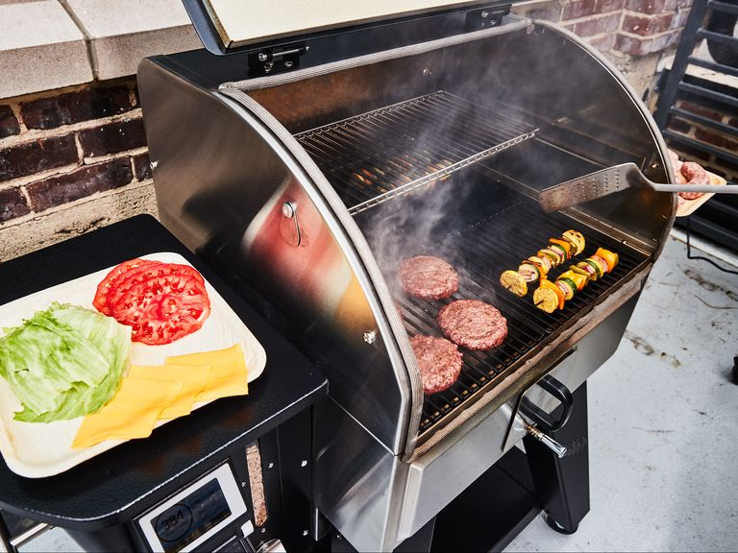
Why might people not want to adopt an electric cookstove?

Slide 10
Policy goal: reduce usage of a fossil fuel appliance
Two policy levers:
Subsidize upfront cost of electric appliance
Subsidize electricity prices
Research question: what is the $/tCO2 for each subsidy?

Slide 11
Planned RCT
Randomize price
Randomize electricity prices
Randomize whether electricity prices are shown before or after adoption decision

